Slide 1
EE5003 - Elevator Pitch Video
By Michael O’Hara - 16414554

Slide 2

Privacy and Security?
What do these two words mean to you?
Privacy in relation to computer systems means the data in the system is not going to be observed by other parties other than the owner.
Security is the methods used by the system to prevent any data inside the system from being access by unauthorized parties.

Slide 3


What technologies can be used to enhance security in computer systems?
Blockchain
IoT could be useful for this. One of the techniques of IoT which could lend itself to the improvement of security systems is Blockchain.

Slide 4
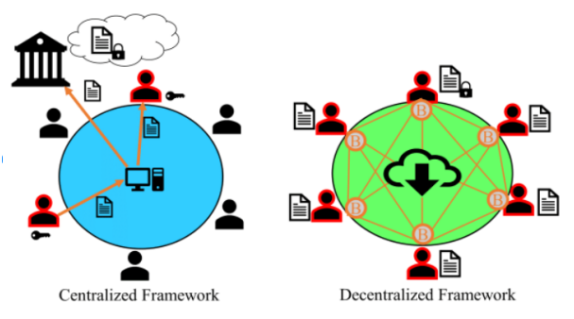
Two types of Blockchain

Slide 5
Blockchain
Blockchain is a type of database which be used in peer-to-peer (P2P) networks. It stores data in blocks chained together
Immutability Once data is entered it can't be edited or removed
Verified Transactions Each action on the DB is verified by other users of the DB

Slide 6
Importance?
Reduce Potential Attacks
Prevent further attacks on healthcare sector and other industries. This protects the systems integrity
Streamline & Modernize Make methods of data collection and storage faster and more efficient. Leading to faster diagnosis and treatment times

Slide 7
Project timeline
Weeks 1-3
Week 7 - 8
Weeks 4 - 6
Week 9 - 10
Decide on the Blockchain technologies & begin implementation
Finish testing and gather results
July |  |  |  |  | August
Continue implementation and begin testing
Conference paper writing & video presentation

